Slide 1

Five Steps to a Successful Endowment
Kathryn W. Miree & Associates, Inc.

Slide 2
What We’ll Cover
We will begin with the role of endowment.
Then, we’ll go through the process of building an endowment in five steps.
Building endowment requires a proactive process.
It’s easy to get lost without a plan - so the last step is to make a plan and set goals.

Slide 3
How Well Do You Know Your Endowment’s Vital Statistics?

Slide 4
Take the Test
1. Does your organization have an endowment?
2. What is the market value of that endowment?
3. What is the current asset allocation of the endowment?
4. How has that asset allocation changed over the last year with the dramatic changes in the markets?
5. What was the total return on your endowment last year? Over the last five years?
6. How do your total returns compare to the blended index?
7. What is the spending policy for the endowment?

Slide 5
Take the Test
8. Are there any restrictions on terms a donor an impose on endowment gifts?
9. Are there any restrictions on the type of assets that can be contributed to your endowment?
10. Who makes decisions about distributions from your endowment?

Slide 6
Score Your Results
Number Answered | Scoring
9-10 | Your donors will be impressed
5-8 | You will survive the conversation
3-4 | Prepare to be humbled.
0-2 | Do you really work there?

Slide 7
An Endowment Overview:
The Role of Endowment

Slide 8
Defining Endowment
Why is a definition necessary?
Each nonprofit has a definition
Each board member may have a definition
Many organizations have funds scattered in a variety of accounts – which are endowment?

Slide 9
The Legal and Practical Definitions
Endowment n. the creation of a fund, often by gift or bequest from a dead person’s estate, for the maintenance of a public institution, particularly a college, university, or scholarship.
ENDOWMENT. The bestowing or assuring of a dower to a woman. It is sometimes used: metaphorically, for the setting a provision for a charitable institution, as the endowment of a hospital.

Slide 10
The Legal and Practical Definitions
Endowment: A permanent fund bestowed upon an individual or institution, such as a university, museum, hospital, or foundation, to be used for a specific purpose. Endowments may be separately held funds within the charity, or separately established nonprofits holding long-term funds generally referred to as supporting organizations to the charity.
7

Slide 11
My Definition
Endowment: Funds set aside for the long-term use of the charity, the principal of which is invested and the earnings of which are used to further the charity’s mission.

Slide 12
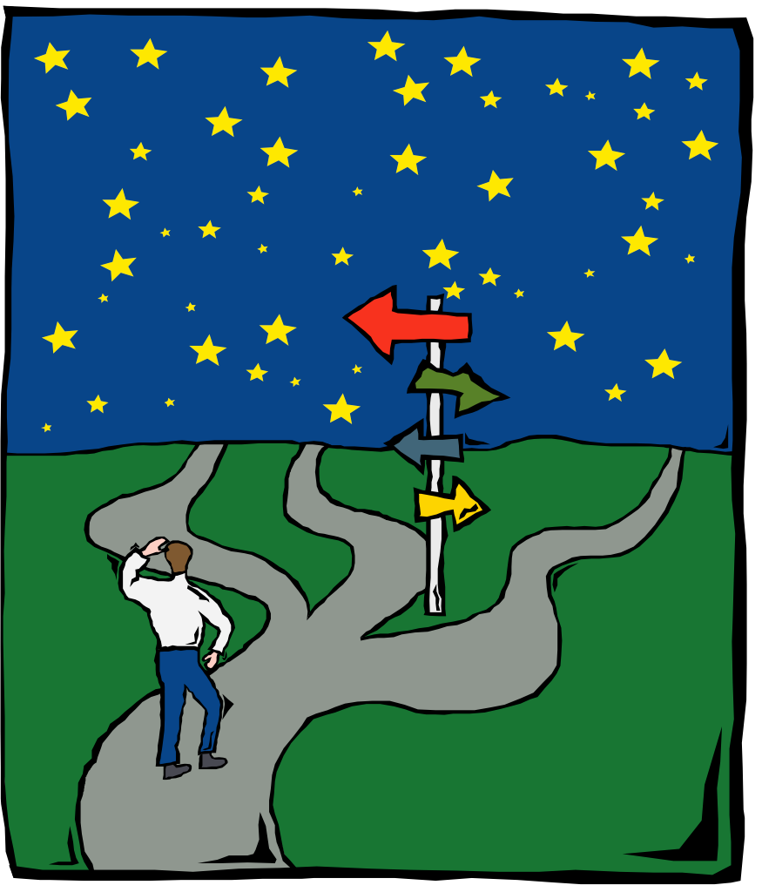
Forms of Endowment
True endowment
Quasi endowment
Term Endowment
Pooled Endowment

Slide 13
The Paradigm Shift
Not too many years ago – endowments were an embarrassment of riches
Now, fiduciary duty
However, the urgency of current programs must be balanced with preparing for the future

Slide 14
Why So Much Talk About Creating an Endowment?
The economy is tough and taking a toll on donors
Fluctuating stock market returns
Low interest rates
Stalled economy

Slide 15
Why So Much Talk About Creating an Endowment?
Key Equity Indexes | 2000 | 2001 | 2002 | 2008 | 2011 | 2015
DJIA | -6.18% | -7.1% | -16.76% | -33.8% | 5.5% | -2.2%
S&P | -10.14% | -13.09% | -23.37% | -38.5% | 0% | -0.7%
NASDAQ | -39.29% | -21.05% | -31.53% | -40.5% | -1.8% | 5.7%

Slide 16
Why So Much Talk About Creating an Endowment?
The prime rate remained at 3.25% from the first quarter of 2009 through mid-December 2015 (rose to 3.5%)
The §7520 rate slipped as low as 1% over this period
Low rates dramatically decrease retirement income adding stress to donors

Slide 17
Why So Much Talk About Creating an Endowment?
Government grants are disappearing – greater needs with less available funds
National Association of State budget Officer – “Fiscal Survey of States”
Medicaid and education are consuming more and more - pensions and infrastructure are also capturing budget funds
Federal government deficit at high

Slide 18
Why So Much Talk About Endowment?
Private foundation grants are shrinking
The number of charities reaching out to your donors is increasing

Slide 19
Do You Need Endowment?
Does the organization serve a purpose or need that is likely to exist on a long-term basis?
Do cyclical economic variances impact the receipt of annual or special event gifts?
Does the organization face increasing operating costs?

Slide 20
Do You Need Endowment?
Does the organization have new programs related to mission that cannot be operated because they lack funding?
Do you anticipate future needs that will require funding?
Do you face increasing competition?
Are you dependent upon grants?
Have you lost gifts because of death?

Slide 21
The Link Between Endowment and Planned Giving
Planned gifts, legacy gifts, and endowment are closely tied
Annual gifts – from income
“Lasting” gifts – from assets
Continuation of the relationship with the donor

Slide 22
The Fundraising Pyramid
Donor Engagement
Nonprofit Outreach
PLANNED GIVING
Transformational
MAJOR GIVING
Transactional and Transformational
ANNUAL GIVING
includes Membership
Transactional

Slide 23
A Strategic Assessment of the Task
Your Strengths:
Visibility in the community and a network of donors
An opportunity to work with and support each other
Knowledge of the needs of your organization and its vision
An active fundraising program on which to build.
Years of information about your donors.

Slide 24
A Strategic Assessment of the Task
Your Weaknesses
You may be new to the process of building endowment.
You may have limited staff.
Further, you may not be trained in the more complex gift transactions that add flexibility and range to donors in making endowment gifts.
You may not have the time to build the infrastructure, assemble and manage the volunteer team, and expand the marketing.

Slide 25
A Strategic Assessment
Your Opportunities:
You’re creating a long-term resource.
An endowment provides funds to capitalize on opportunities or expand strategically.
You’ll have resources to respond quickly to critical and urgent needs.
You’ll have resources to take on new ventures not covered by annual revenue.

Slide 26
A Strategic Assessment of the Task
Your challenges:
Articulating the case for endowment and integrating that case into your messaging.
Finding the time to prioritize endowment and give it the attention it needs.
Changing the culture of your organization.
Positioning endowment to encourage donors to make annual, capital, and endowed gifts.

Slide 27
Ready to Go?
Step One: Create a case for endowment
Step Two: Build an infrastructure for endowment
Step Three: Build the team to build endowment
Step Four: Market the endowment and begin to talk with donors
Step Five: Make a plan to create and build endowment and set goals

Slide 28
Step One: Making the Case for Endowment

Slide 29
The Case Statement
The internal case for support:
Start by building the case among staff and board
Why do you need endowment?
Take the board through the exercise of answering these questions:
Do you have a long-term purpose?
Do cyclical economic variances impact annual fund?
Do you have new programs you want to pursue – but no dollars?

Slide 30
The Case Statement
The questions, continued:
Do you anticipate future needs not currently funded?
Is there more competition for annual gifts?
Are you dependent on grants?
Are you losing donors through mortality, or a move from the community?

Slide 31
The Six Greatest Concerns
How can we hold money for the future, when there are so many needs today?
We will appear rich.
We don’t want restrictions on gifts.
Won’t endowment giving hurt annual giving?
These gifts seem complicated.
This process costs money.

Slide 32
The Case Statement
The external case – why donors should give
Should inspire vision
Should inspire passion
Should be urgent
Should involve the donor

Slide 33
Step Two: Building an Infrastructure to Support Endowment

Slide 34
The Perfect Profile for Success
An organization that has been in existence for at least 8 to 10 years.
A history of strong program growth.
A growing fundraising program.
Stable nonprofit staff.
A financial officer with an understanding of and ability to manage endowment.
Commitment of the board of directors.

Slide 35
A Survey of Managers: The Most Common Problems
Administrative costs that are too large a percentage of revenue
Proliferating and scattered funds
Managing the paperwork
Allocating restricting funds to designated purposes and proving it
Funds that outlive their purpose
Negative investment returns
Litigious donors

Slide 36
The Endowment Structure: Form
Type of Entity | Pros | Cons
Segregated account with the charity | Low cost Flexible | Vulnerable Changing boards Liability
Stand alone foundation | Protection from liability and spending Separate board | High cost to create and operate Under scrutiny Takes time
Community Foundation | Does everything Visible and credible | Not your assets Little input

Slide 37
Other Issues
Consolidation
Can’t manage easily if funds are scattered
Must distinguish between true and quasi-endowment
Put your hands on endowment documents
Designated gifts
Need policies:
Size
Limited purpose
Accounting cost

Slide 38
One Solution

Slide 39
Allow Gift Options at All Levels
Level of Giving | Designation of Use | Recognition
$1 - $49,999 | May designate sector | Recognized in year of gift
$50,000 - $249,999 | May designate sector | Recognized in year of gift and annually in association with sector
$250,000+ | May designate sector and purpose | Recognized in year of gift and annually

Slide 40
Gift Acceptance Policies
Primary benefit is to maintain discipline, while opening doors to additional assets
Often come late in a development program as charities move beyond cash and marketable securities
There is organizational and board liability for mistakes.

Slide 41
Gift Acceptance Policies – Why?
Decisions on a case by case scenario are inconsistent.
The glittering appeal of the gift obfuscates good judgment.
Without policies, you may send mixed signals to donors.
Good policies will keep donors from making mistakes.

Slide 42
Spending Policies
Spending policy for endowed funds
Principle distributions from quasi-endowment

Slide 43
Clear Investment Policies
Laws governing investment management
Check state law
UMIFA - 1972
UPMIFA - 2006
Change in prudence standards standards for investment
Change in spending policy requirements - historic dollar value
Changing and releasing the use or purpose of fund

Slide 44
Other Considerations
Adopt written investment policies that guide asset allocation, restrictions on risky assets, and clear objectives and statements of risk.
Articulate your goals for the investment manager.
Use a qualified professional manager
Monitor the manager.
Do not invest in an asset you cannot understand.

Slide 45
The Endowment Agreement
The importance of shared expectations
Creating flexibility
Solving problems with current documents
Typical problems
Investment restrictions
Distribution restrictions
Small funds
Options in solving problems
Document solutions
Living donors
Statutory solutions
Judicial solutions

Slide 46
Accounting and Accountability
Reporting to stakeholders
Getting the work done
Internal management
Third party firm for management

Slide 47
Step Three: Building the Team

Slide 48
Building the Endowment Team
Be patient – endowments and legacies take time
Remember you’re working with your best donors
Build a well-informed, motivated, inspired team
Each individual should understand the role they play in success

Slide 49
The Role of the Board
Engage in planning
Participate in endowment design
Ask questions!
Ensure accountability
Review regular report on progress
Support process in budget
Provide support in outreach
Adopt policies, including ethics
Consider a gift!

Slide 50
The Role of Staff: CEO
Drive strategic planning
Oversee case statement and Deferred Giving Plan
Ensure board is on board
Make regular reports to board and staff
Recruit planned giving committee
Draft resolution to commit gifts to endowment
Assign oversight of endowment
Create endowment agreements
Set goals
Prepare gift proposals
Report gifts
Support calls

Slide 51
The Role of Staff - CFO
Review administrative requirements
Make checklist for endowment support
Work with gift acceptance committee
Work with investment committee
Prepare quarterly and annual investment reports
Follow through on receipt of gifts

Slide 52
The Role of Staff - Development Officer
Training
Infrastructure
Gift acceptance policies
Endowment policies
Investment policies
Trained staff
Endowment management
Prepare marketing materials
Provide support in accepting and designing gifts
Work with counsel to create endowment agreements

Slide 53
Role of Volunteers
Embrace learning curve!
Learn to articulate the case
Consider a personal gift
Gift thought to the impact of your gift
Make the calls!
Get help when you need it
Work with CEO on case statement and endowment plan
Identify budget needs
Commit to annual goals
Close gifts

Slide 54
Step Four: Marketing to Donors

Slide 55
Opportunities for Donors
Creating a Legacy is a joy – not a burden.
Donor can select the charity and purpose for the endowment gift
The gift can involve or honor family
The gift should fit within context of other planning
Opportunity to give back
Opportunity to change the world

Slide 56
Challenges to Donors
It is uncomfortable to talk about bequests or death – “I’ll take care of it later.”
How do I balance family with charity?
Where do I start?
Why do you need the money?
I’m not wealthy.
This is complicated.
My family doesn’t live here.

Slide 57
The Many Facets of Donor Motivation
A commitment to your organization because of its role
Commitment to “give back”
Services provided
Contribution to quality of life
Personal gratitude for success

Slide 58
The Many Facets of Donor Motivation
Memorial
Facilitating change
Desire to influence or control activities
Guilt
Tax incentives

Slide 59
Type of Gift Vehicles Used
Type of Gift | % Who Have Created
Capital campaign | 64.6%
Bequest | 41.2%
Stocks/mutual funds | 31.8%
Created foundation | 19.5%
Created donor advised fund | 15.9%

Slide 60
Important Motivations for Giving
Motivation | % of Respondents Citing
Meet critical needs | 86.3%
Giving back to society | 82.6%
Reciprocity | 81.5%
Bring about a desired impact | 68.5%
Nonprofits should do what government cannot do | 64.4%

Slide 61
Factors That Would Prompt Additional Gifts
Factor | % of Respondents Citing
Spent less money on administration | 74.8%
Donor can determine impact of gift | 58.3%
Donor felt more financial secure | 52.0%
Donor received better return on investments | 46.6%
Donor not already financially committed | 40.2%

Slide 62
Center on Philanthropy at IU Bequest Study
Report in March 2007
Combined high net worth with surveys in Indiana, St. Louis, Memphis
Goal to identify potential bequest donors, and donor motivation
48.4% had a will
FindLaw 44.4% (2002)
NCPG 42% (2000)

Slide 63
Age Demographics for Those With Bequest in Place
Age | Bequest Study | HNW Philanthropy Study
30-40 | 8.9% | 1.4%
40-50 | 28.1% | 9.4%
50-60 | 21.9% | 19.3%
60-70 | 20.6% | 27.5%
70-80 | 11.0% | 25.1%
80+ | 8.9% | 17.3%

Slide 64
Age Demographics for Those Willing to Consider a Bequest
Age | Bequest Study | % of Sample
30-40 | 18% | 18.2%
40-50 | 28% | 28.8%
50-60 | 24% | 18.3%
60-70 | 5% | 10.9%
70-80 | 3% | 7.8%
80+ | 1% | 3.7%

Slide 65
Bequest Intention Potential
 | >$25,000 | $25,000 to $49,999 | $50,000 to $74,999 | $75,000 to $99,999 | $100,000+
Bequest currently in place | 6.6% | 7% | 7.6% | 6.5% | 10%
Would consider putting a bequest in place | 28.4% | 34.6% | 28.8% | 25.99% | 35.63%

Slide 66
Identifying the Best Prospects
Internal:
Multi-year donors
Members
Major gift donors
Long-term leadership
Long-term volunteers
Current board
Corporate leadership
Staff

Slide 67
Finding the Best Prospects
External
Community investors
Always start internally

Slide 68
Educating Prospects (Marketing)
Integrating the Legacy Message in Current Platforms
Annual report
Website
Annual fund solicitations
Substantiation and “thank you” letters
Stationery
Newsletter
Board meetings
Annual appreciation luncheon

Slide 69
Setting Expectations
Keep the endowment and its impact visible year round.
Its all about expectations and communication.
Position endowment as part of your organization’s success.
Ask donors to participate.
Make it clear that donors at all levels can have a significant impact.

Slide 70
Communication
Board reports
Website
Development materials
Newsletters, magazines, other platforms
Stay in touch with donors and their families

Slide 71
Step Five: Making a Plan and Setting Goals

Slide 72
Create a Written Plan
Incorporate the results of the assessment of infrastructure and readiness
Don’t forget other key elements
Address the budget
Assign a timeline
Commit to ongoing reporting
Update progress quarterly
Track progress internally with a one page report
Report progress externally by thanking donors and reporting impact

Slide 73
Create a written plan
Action Steps | Who’s in Charge? | Staff/Volun. Needed | $$ Required | Timeline
1
2
3
4

Slide 74
Final Thoughts
and
Questions

